Slide 1
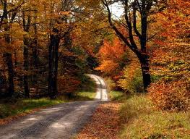
Welcome To English Class

Slide 2

Nizam Uddin Jewel
Assistant Teacher
Baher Cor govt.primary school, Raypura, Narsingdi.
Email:nizamuddinjewel
@gmail.com

Slide 3

Class:Five
Sub:English
Lesson:24,
Unit:1st 8 lines
Page:85

Slide 4
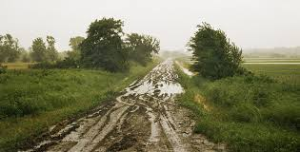
Learning outcomes::
Students will be able to:
read the poem with correct pronunciation and stress.
2)Know about City Streets and Country Roads.

Slide 5

Safe learning environment: by watching video clip

Slide 6
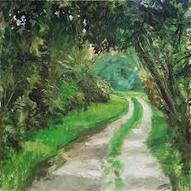
City Streets and
Country Roads

Slide 7

Teachers loud reading

Slide 8
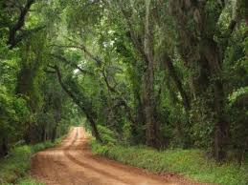
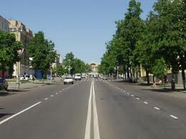
The city has streets
But the country has roads

Slide 9
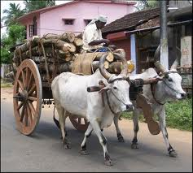
In the country one meets
Bullock carts with their loads.

Slide 10
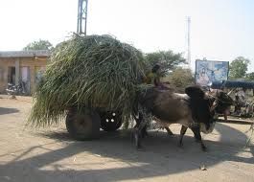
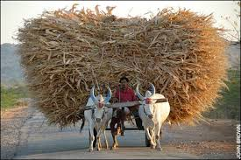
Of sweet smelling hay
And crops and grain:

Slide 11
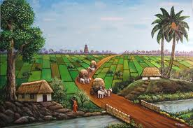
Oh, take me away
To the country again

Slide 12
Students loud reading

Slide 13
New words: Street, Country

Slide 14
Word meaning
Streets : Big road
Country : village

Slide 15
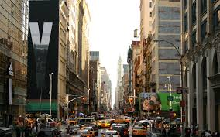
Make sentence
Street : The city has streets
Country: Take me away to the country.

Slide 16
Silent reading

Slide 17
Rearrange lines
The city has streets-
Bullock carts with their loads
In the country one meets
But the country has roads
And crops and grain
Of sweet smelling hay,

Slide 18
Group work
Group A
Read the poem 1st 4 lines
Group B
Read the poem
5th-8th line

Slide 19
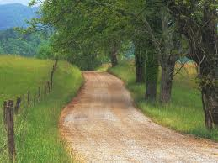
Home work.
Write 5 sentence about your country roads.

Slide 20
Thanks my dear students, bye, see you tomorrow

